Slide 1

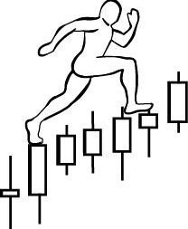
Homework #5:
due on February 11th , 2019
Exercise: Distribution Labeling
Assignment: Label trading ranges with Wyckoff Phases and Events, and CHoCH
www.WyckoffAnalytics.com Copyright © 2018 Wyckoff Associates, LLC. All Rights Reserved.

Slide 2
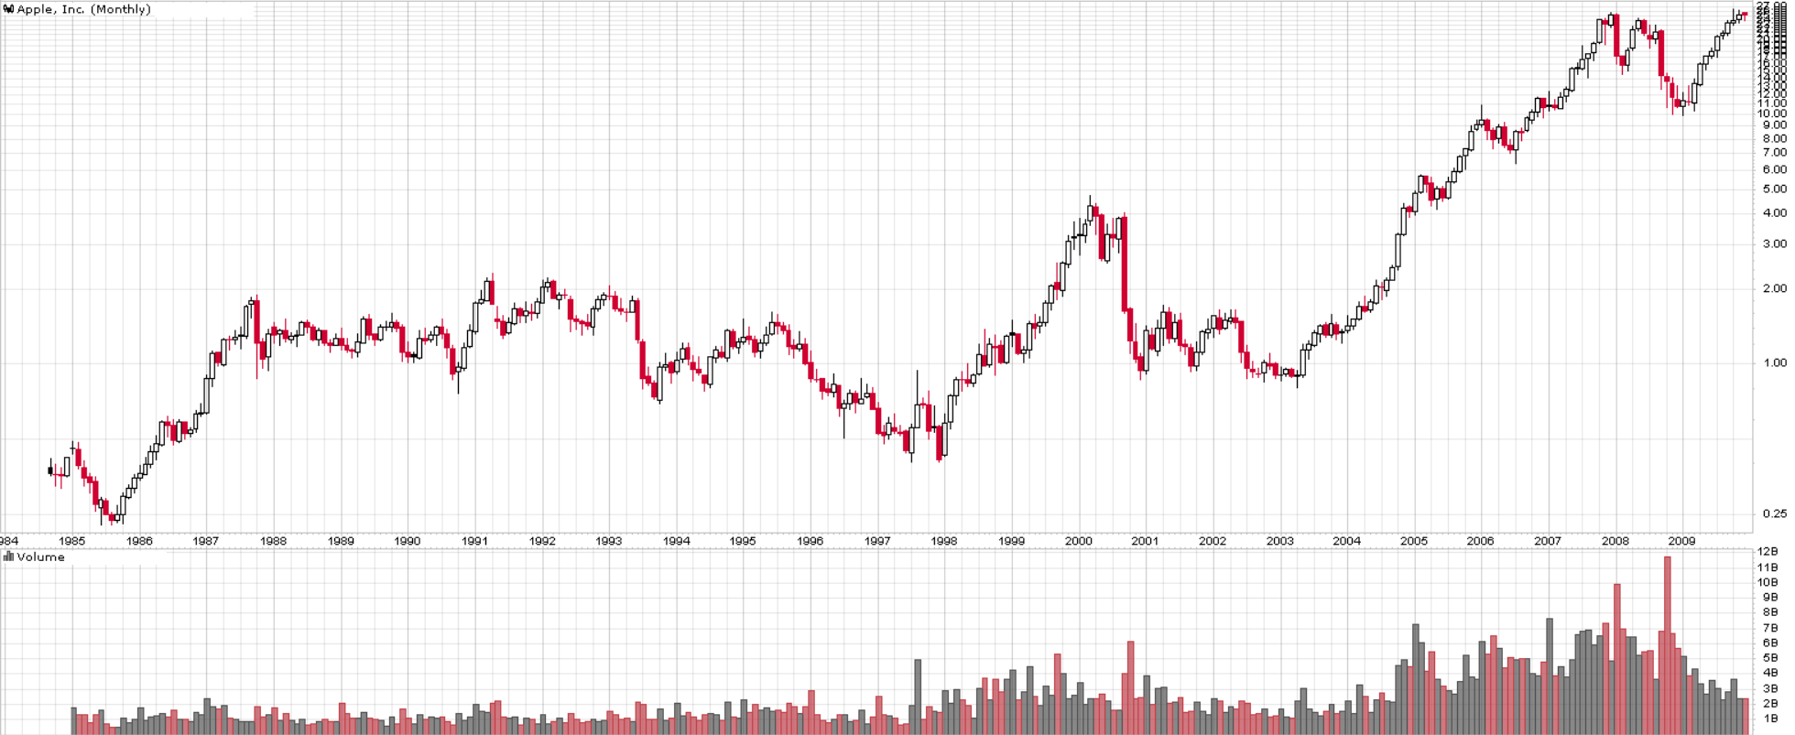
Homework Exercise #5: AAPL -1
www.WyckoffAnalytics.com Copyright © 2019 Wyckoff Associates, LLC. All Rights Reserved.

Slide 3
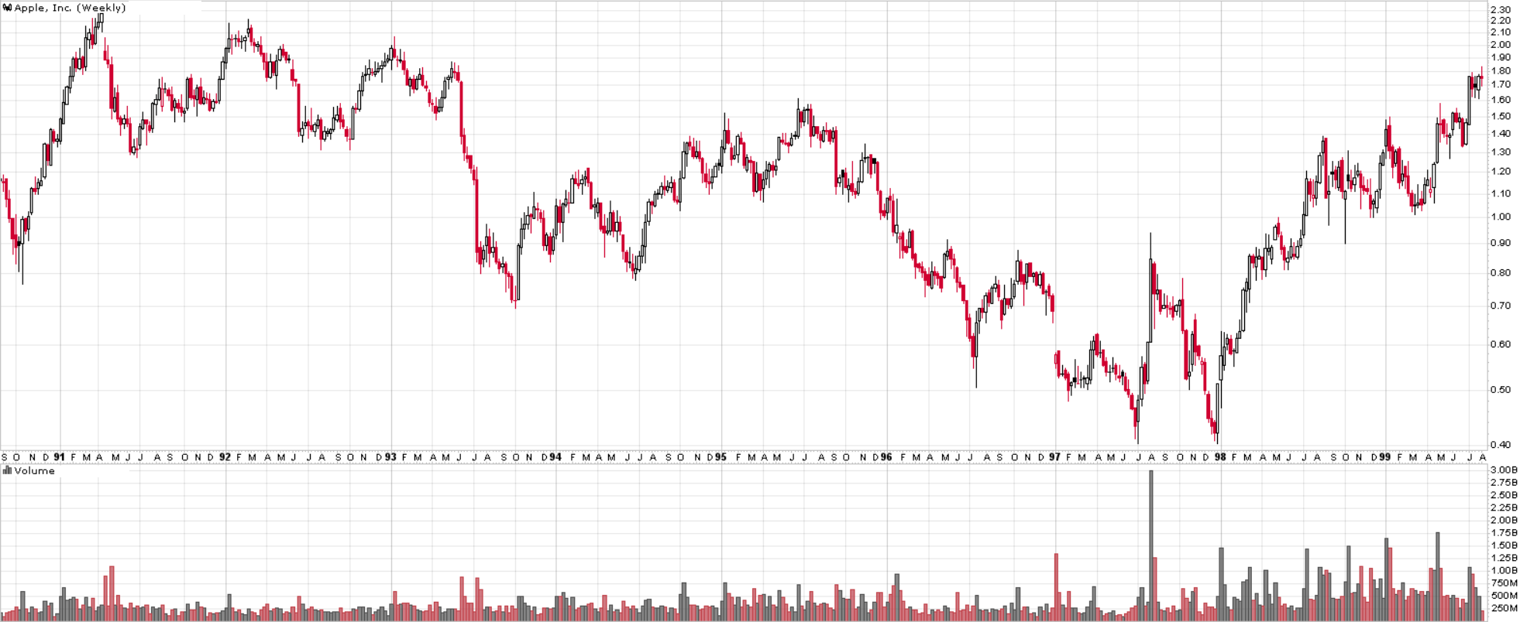
Homework Exercise #5: AAPL - 2
www.WyckoffAnalytics.com Copyright © 2019 Wyckoff Associates, LLC. All Rights Reserved.

Slide 4
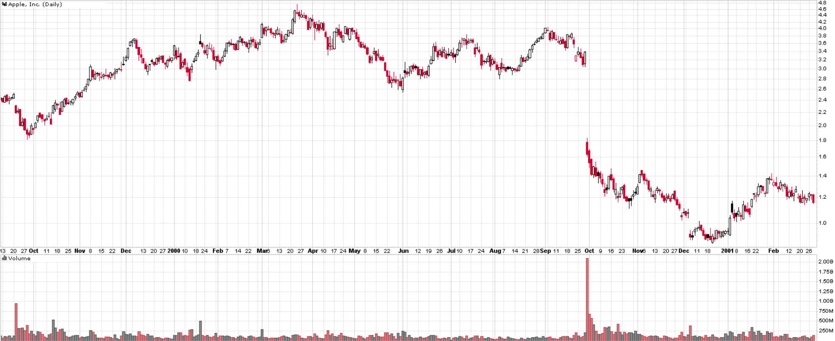
Homework Exercise #5: AAPL - 3
www.WyckoffAnalytics.com Copyright © 2019 Wyckoff Associates, LLC. All Rights Reserved.

Slide 5
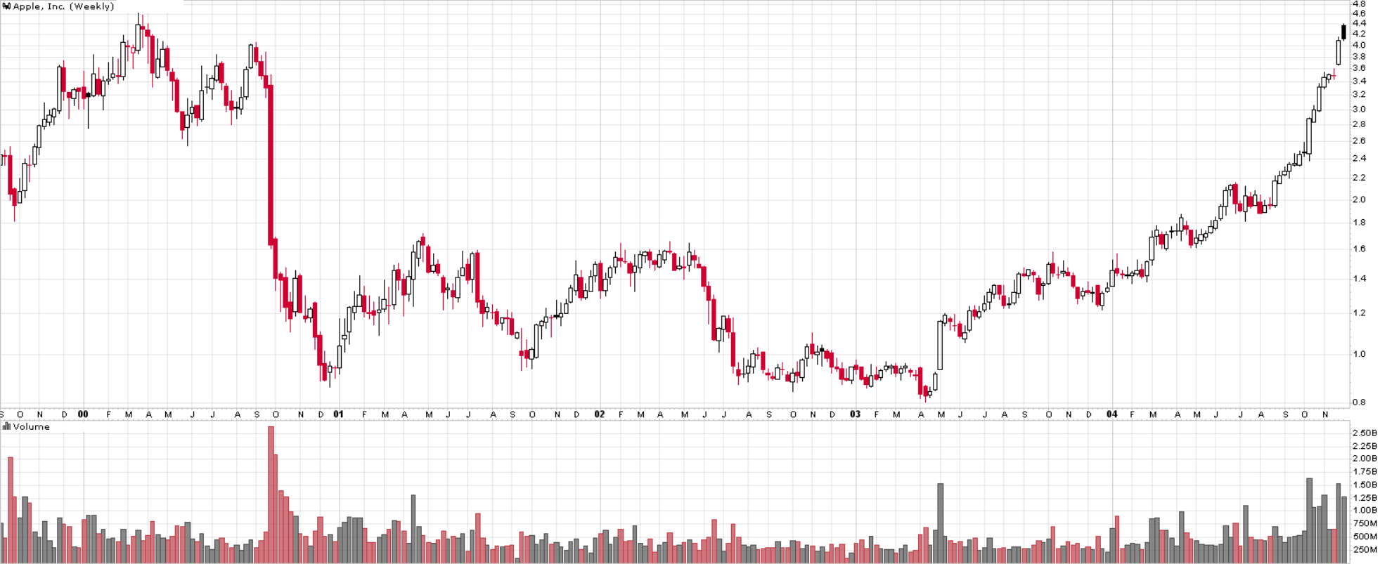
Homework Exercise #5: AAPL -4
www.WyckoffAnalytics.com Copyright © 2019 Wyckoff Associates, LLC. All Rights Reserved.

Slide 6
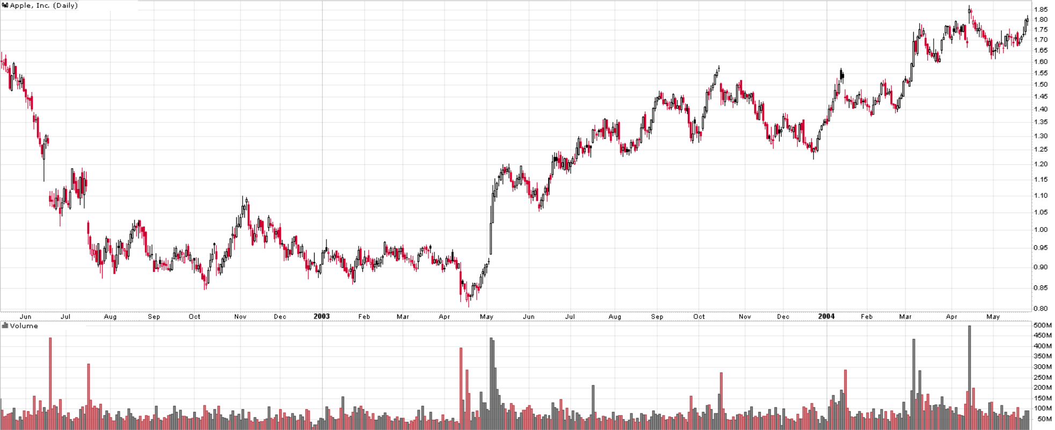
Homework Exercise #5: AAPL -5
www.WyckoffAnalytics.com Copyright © 2019 Wyckoff Associates, LLC. All Rights Reserved.

Slide 7
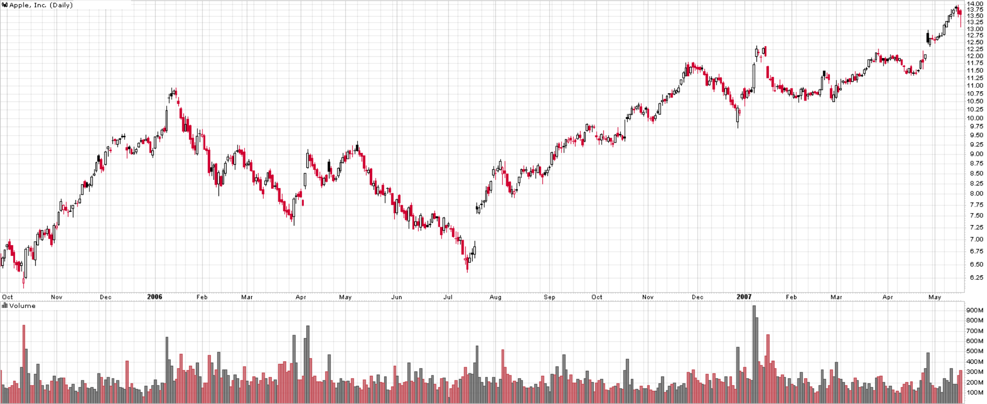
Homework Exercise #5: AAPL -6
www.WyckoffAnalytics.com Copyright © 2019 Wyckoff Associates, LLC. All Rights Reserved.

Slide 8
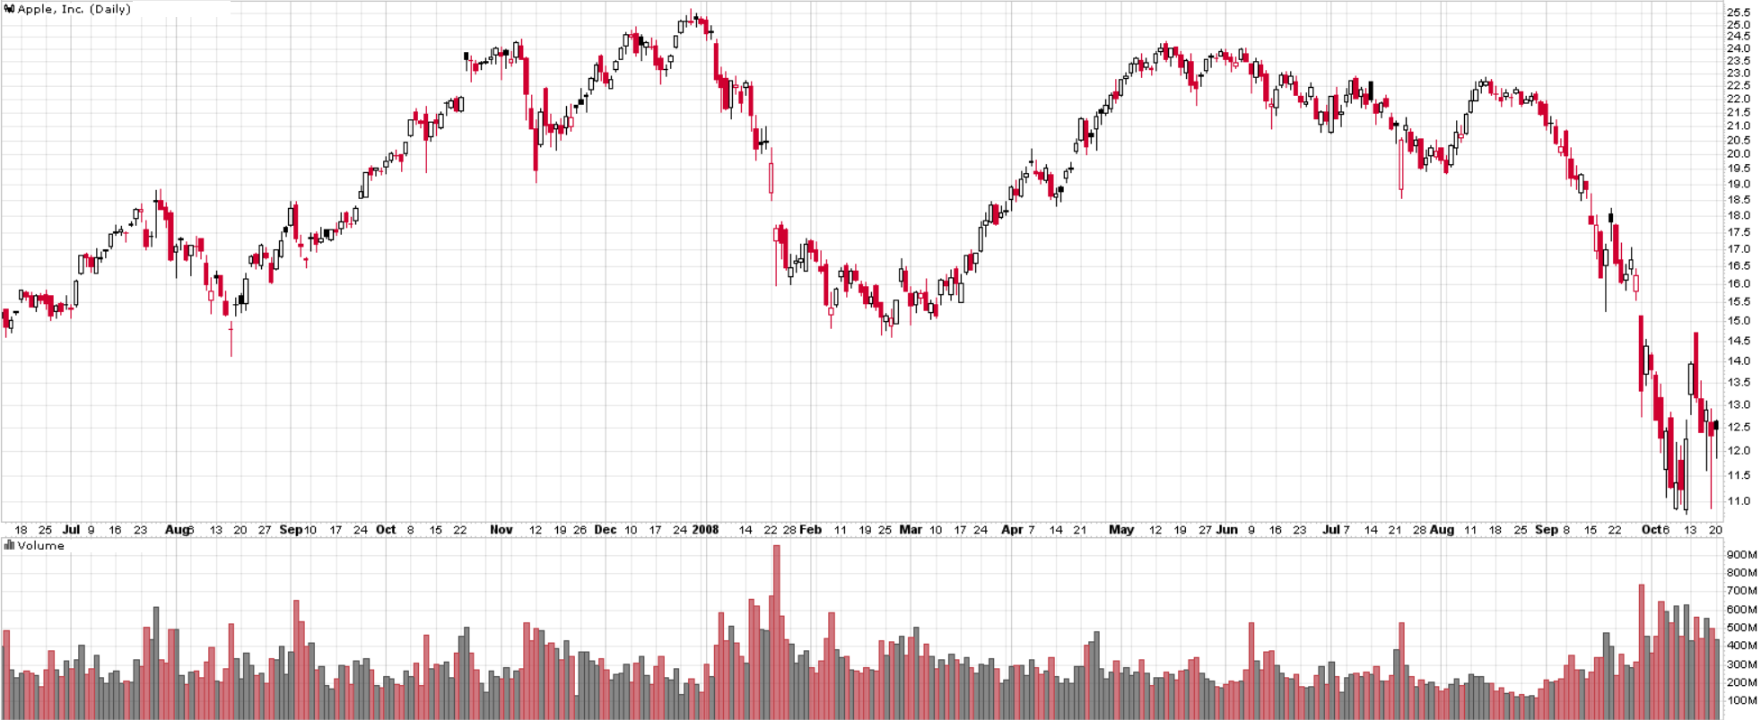
Homework Exercise #5: AAPL -7
www.WyckoffAnalytics.com Copyright © 2019 Wyckoff Associates, LLC. All Rights Reserved.

Slide 9
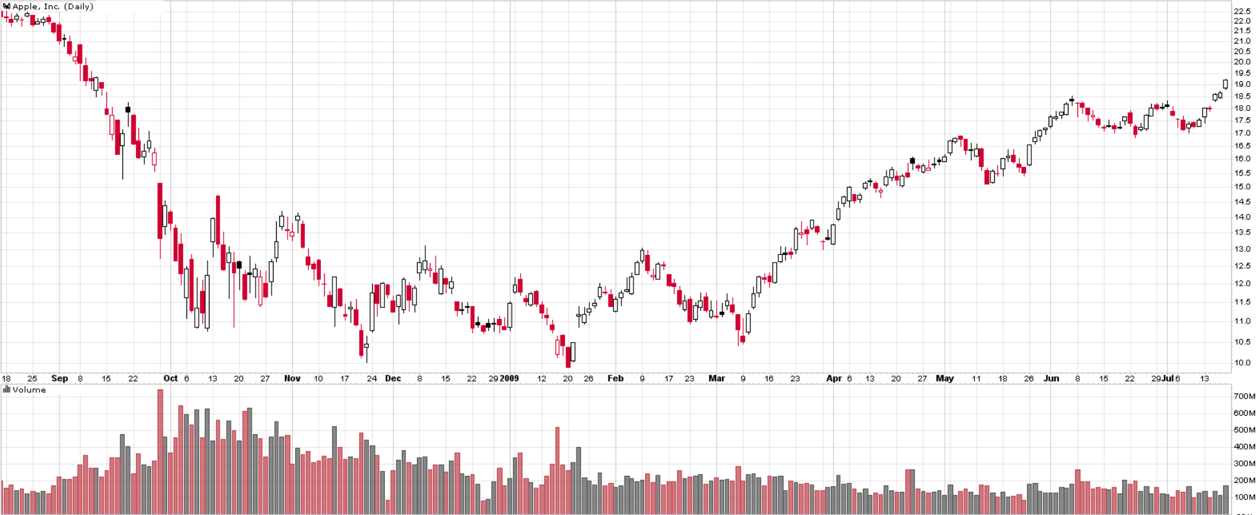
Homework Exercise #5: AAPL -8
www.WyckoffAnalytics.com Copyright © 2019 Wyckoff Associates, LLC. All Rights Reserved.

Slide 10
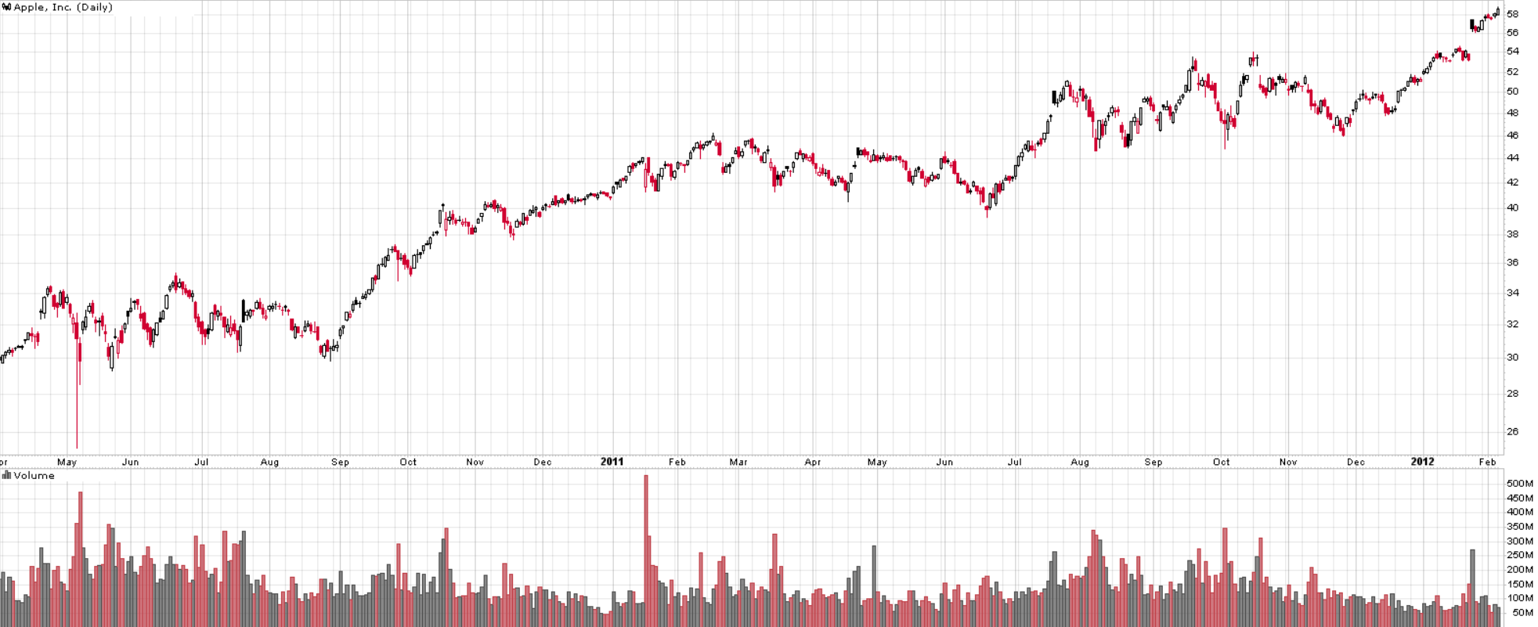
Homework Exercise #5: AAPL -9
www.WyckoffAnalytics.com Copyright © 2019 Wyckoff Associates, LLC. All Rights Reserved.

Slide 11
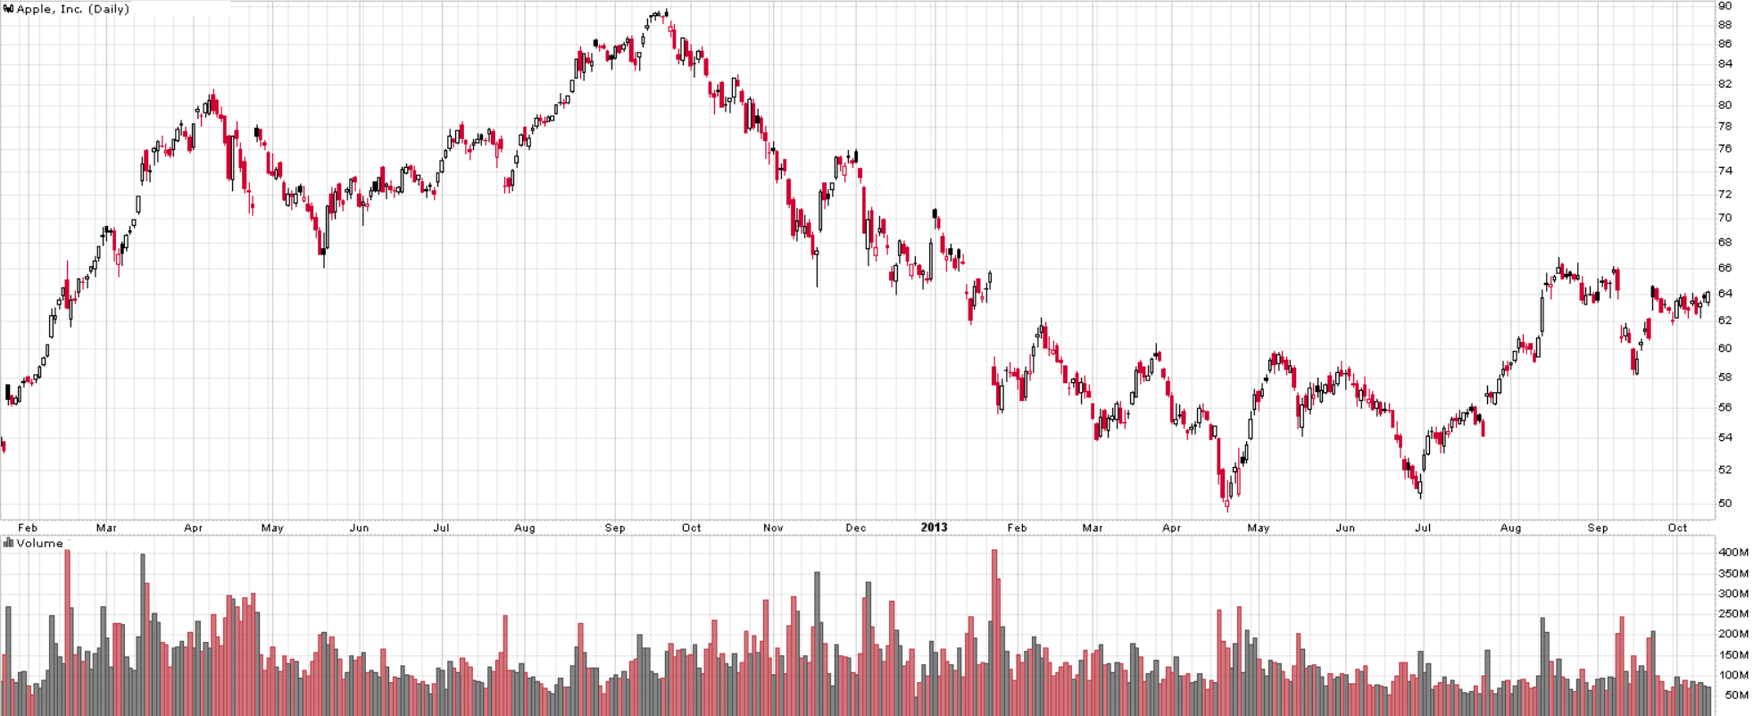
Homework Exercise #5: AAPL -10
www.WyckoffAnalytics.com Copyright © 2019 Wyckoff Associates, LLC. All Rights Reserved.

Slide 12
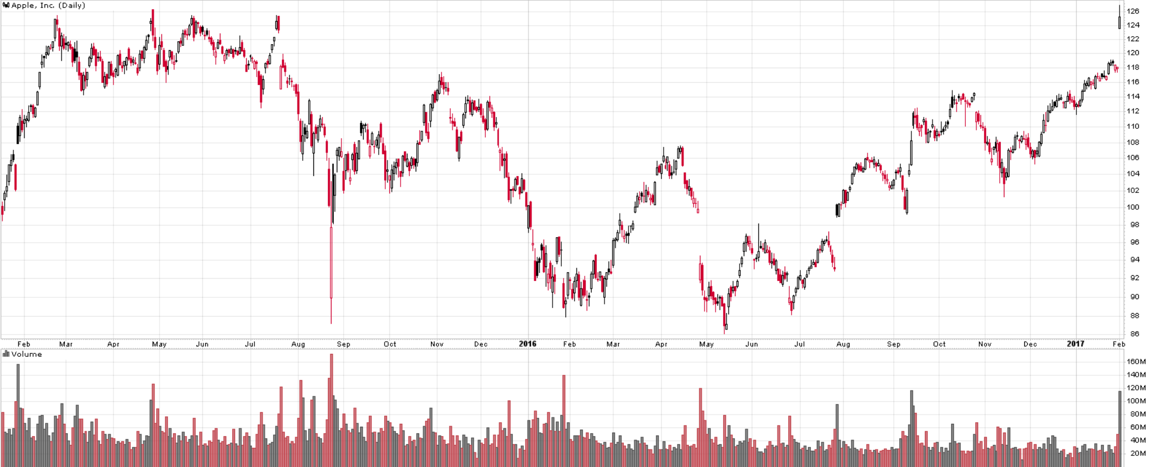
Homework Exercise #5: AAPL -11
www.WyckoffAnalytics.com Copyright © 2019 Wyckoff Associates, LLC. All Rights Reserved.

